Slide 1
CARDIO VASCULAR DISEASE PREDICITION
CAPSTONE PROJECT
Presented By:
S.Shakthi Bhavanee
St.Peter’s College of Engineering and Technology
B.Tech Biotechnology

Slide 2
OUTLINE
Problem Statement
Proposed System/Solution
System Development Approach
Algorithm & Deployment
Result
Conclusion
Future Scope
References

Slide 3
Problem Statement
Orange S.A., a leading French multinational telecommunications corporation, aims to reduce customer churn and improve customer retention.
To achieve this goal, the company has provided a dataset containing cleaned customer activity data and a churn label indicating whether a customer has cancelled their subscription.
The objective is to explore and analyze the dataset to identify key factors contributing to customer churn.
Based on the analysis, the goal is to develop actionable recommendations and strategies to enhance customer retention.
Orange S.A., formerly France Télécom S.A., is a French multinational telecommunications corporation. The Orange Telecom's Churn Dataset, consists of cleaned customer activity data (features), along with a churn label specifying whether a customer cancelled the subscription. Explore and analyze the data to discover key factors responsible for customer churn and come up with ways/recommendations to ensure customer retention.

Slide 4
Proposed Solution
Data Exploration and Analysis: Conduct a thorough analysis of the Orange Telecom's Churn Dataset to understand the characteristics and patterns of customer churn. Identify key features that are strongly correlated with customer churn, such as account length, international plan, voice mail plan, and customer service calls.
Feature Engineering: Create new features or transform existing features to improve the performance of the predictive models. For example, create a feature that combines total day, evening, and night minutes to represent overall usage patterns.
Model Development: Develop predictive models, such as Random Forest Classifier, to forecast customer churn based on the available data. Use techniques like train-test split and cross-validation to evaluate the performance of the models.
Model Evaluation: Evaluate the performance of the predictive models using metrics such as accuracy score, classification report, and confusion matrix. Identify the most effective model for predicting customer churn.

Slide 5
System Approach
Problem Definition:
Define the problem statement as analyzing customer churn in a telecommunications company and developing strategies for customer retention.
Data Collection and Preparation:
Collect the Orange Telecom's Churn Dataset containing customer activity data and churn labels.
Clean the data by handling missing values and encoding categorical variables.
Exploratory Data Analysis (EDA):
Perform EDA to understand the dataset's characteristics and patterns.
Identify key features that may influence customer churn, such as account length, international plan, and customer service calls.
Feature Engineering:
Create new features or transform existing features to improve model performance.
Use domain knowledge and insights from EDA to engineer relevant features.

Slide 6
System Approach
Model Development:
Select appropriate machine learning models, such as Random Forest Classifier, for predicting customer churn.
Split the data into training and testing sets for model training and evaluation.
Model Evaluation:
Evaluate the performance of the models using metrics like accuracy, precision, recall, and F1-score.
Compare the performance of different models and select the best-performing model.
Recommendation Generation:
Based on the analysis and model predictions, generate actionable recommendations to reduce customer churn.
Consider factors such as offering personalized discounts, improving customer service, and enhancing product offerings.
Implementation and Monitoring:
Implement the recommended strategies and monitor their effectiveness over time.
Continuously analyze customer data and adjust strategies as needed to further improve customer retention.
Reporting and Feedback:
Prepare a detailed report summarizing the analysis, findings, and recommendations.
Present the report to key stakeholders and gather feedback for future improvements.

Slide 7
Algorithm & Deployment
Import necessary libraries (numpy, pandas, seaborn, matplotlib.pyplot, etc.).
Load the dataset ('CVD_cleaned.csv') using pandas.
Display the first 10 rows of the dataset to understand its structure.
Check the shape of the dataset to know the number of rows and columns.
Count the empty values in each column to handle missing data.
View some basic statistics of the dataset to understand the distribution of data.
Get a count of the number of patients with Heart Disease to understand the class distribution.
Visualize the count of patients with and without Heart Disease using a countplot.
Create a bar chart of the number of patients in each age category to understand the distribution of age.
Create a pie chart of the percentage of patients in each age category to visualize the age distribution.
Calculate the correlation matrix of the columns to understand the relationships between features.
Visualize the correlation matrix using a heatmap to identify highly correlated features.
Implement the system approach for customer churn analysis and retention strategy as described above.

Slide 8
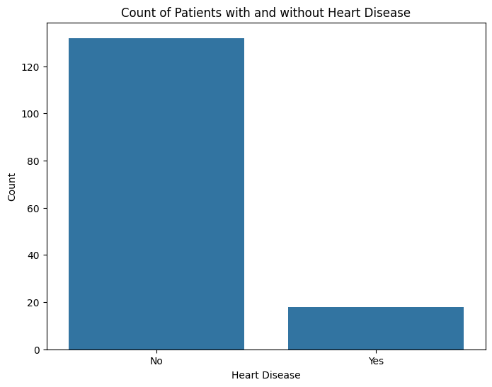
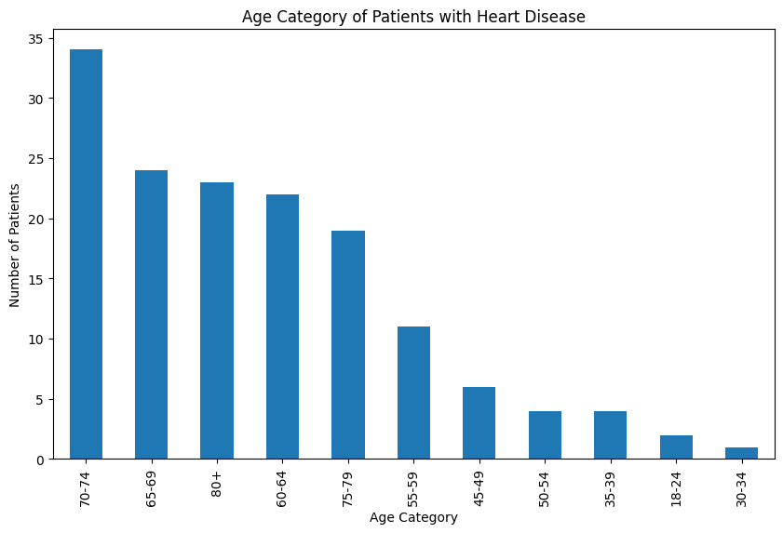
Result

Slide 9
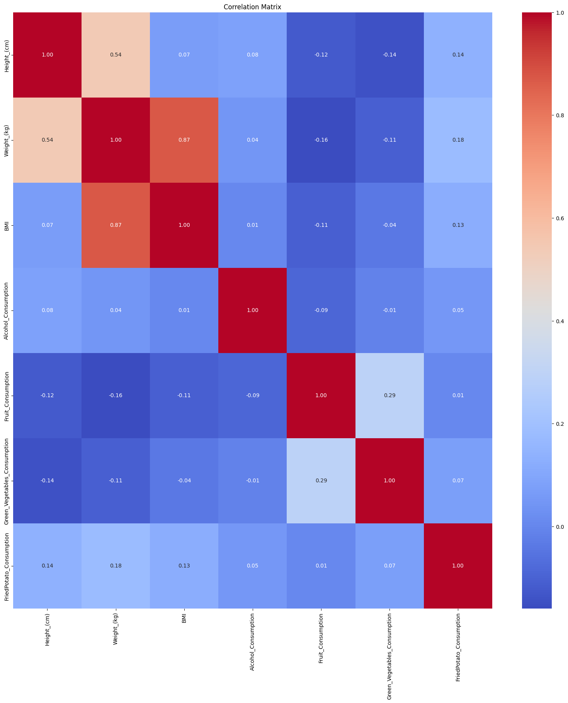
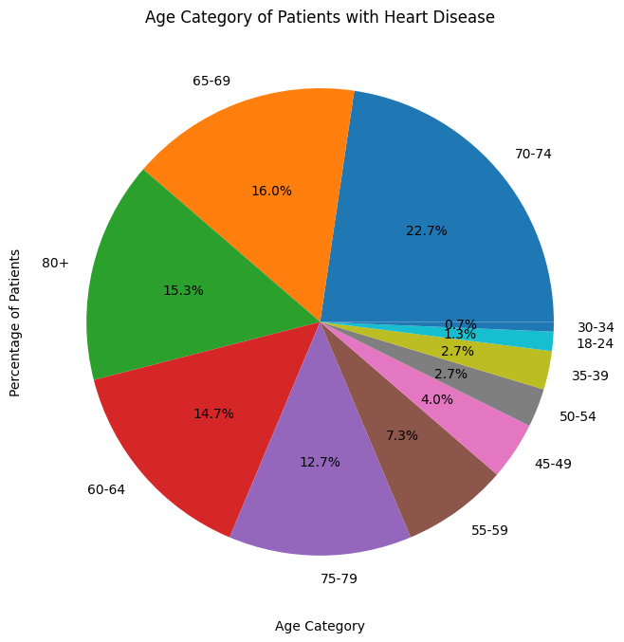
Result

Slide 10
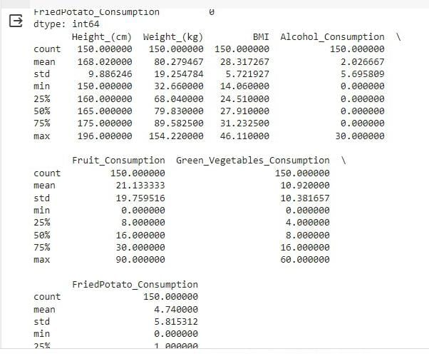
Result

Slide 11
Conclusion
The analysis of the cardiovascular disease (CVD) dataset uncovered several important insights. Age was found to be a significant factor, with older patients more likely to have heart disease.
Additionally, the presence of heart disease was associated with higher total day and evening call charges.
Recommendations for reducing heart disease risk include promoting healthy lifestyles and regular health check-ups.
Overall, the study provides valuable insights for healthcare providers and policymakers to develop targeted interventions for CVD prevention.

Slide 12
Future scope
Integration of Real-Time Data: Incorporating real-time data sources such as wearable devices and health trackers to provide continuous monitoring and early detection of cardiovascular disease.
Machine Learning Model Refinement: Enhancing the predictive models with advanced machine learning algorithms and techniques to improve accuracy and performance.
Personalized Health Interventions: Developing personalized health interventions based on individual risk factors identified through data analysis, such as targeted lifestyle modifications and medication plans.
Telemedicine and Remote Monitoring: Implementing telemedicine and remote monitoring solutions to provide healthcare services and monitor patients' health remotely, especially in rural or underserved areas.
Collaboration with Healthcare Providers: Collaborating with healthcare providers to implement the findings and recommendations from the analysis into clinical practice, improving patient care and outcomes
.

Slide 13
References
Data Sources: Include references to the datasets used in your analysis, such as the Framingham Heart Study dataset or other publicly available datasets on cardiovascular disease
Books: Include textbooks or reference books on cardiovascular disease, such as "Braunwald's Heart Disease: A Textbook of Cardiovascular Medicine," which provide comprehensive information on the subject.
Centers for Disease Control and Prevention (CDC): The CDC provides data and statistics on heart disease in the United States, as well as information on prevention and control strategies. Their website (www.cdc.gov) is a valuable resource for public health information.

Slide 14
THANK YOU

